Slide 1
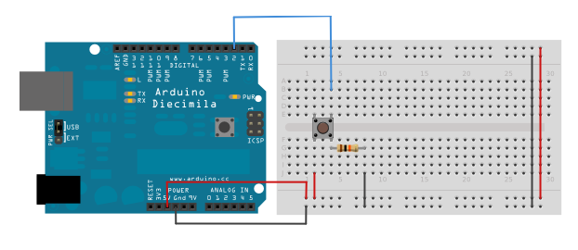
Connecting a Pushbutton as a Discrete Input

Slide 2
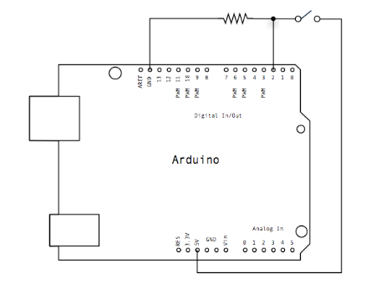
Connecting a Pushbutton as a Discrete Input

Slide 3
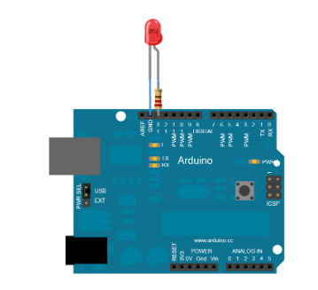
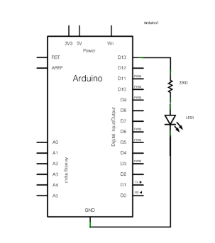
Connecting an LED as a Discrete Output

Slide 4
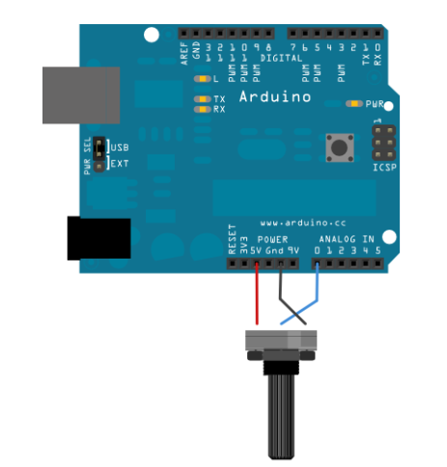
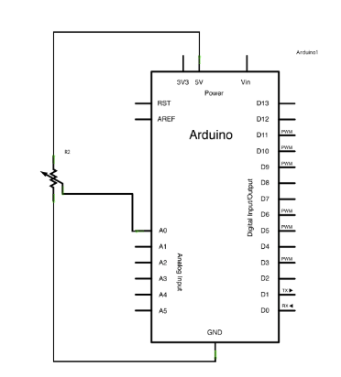
Connecting a Potentiometer as an Analog Input

